Slide 1
Welcome to Artificial Intelligence!
Ernest Davis
September 3, 2020

Slide 2
What is Artificial Intelligence?

Slide 3
What is Artificial Intelligence?
Constructing an intelligent agent. (Russell and Norvig, earlier editions)
The computational study of cognition (Charniak and McDermott, 1985)
My definition: There are tasks that are easy − even automatic − for human but very hard to program computers to do:
Vision, Manipulation and motion, Language, Some forms of learning, Some forms of reasoning
AI is the study of how to get computers to do those.

Slide 4
Two major approaches to AI
Knowledge-based AI (first half of this semester)
Corpus-based machine learning (second half of this semester)

Slide 5
Knowledge-based AI
Analyze the knowledge that is necessary to carry out intelligent tasks
Determine how that knowledge can be expressed symbolically
Build programs that use that knowledge.
The representation of knowledge is
Symbolic. DayOfWeek(September,3,2020) = Thursday
∀_{x,y} Parent(x,y) ⇒ Older(x,y).
Transparent. A human looking at a symbolic expression can interpret it.
Modular. The knowledge base consists of propositions, each of which is meaningful by itself.

Slide 6
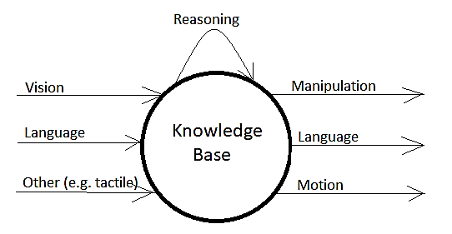
Architecture of Knowledge-Based AI

Slide 7
Corpus-based Machine Learning
A specific task to carry out:
Tag photos with the category of image shown
Translate from Spanish to Urdu
Build a chatbot
A corpus of relevant data
(Either successful executions of the task or otherwise relevant)
Collection of labelled images
Collection of bitexts in Spanish and Urdu
A body of conversations
An automated measure for evaluating success

Slide 8
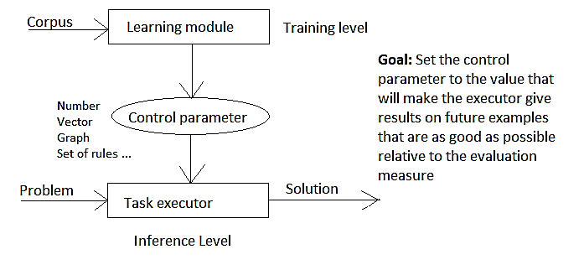
ML Architecture

Slide 9
Characteristics of Machine Learning (particularly neural networks/deep learning)
Opaque. It is difficult or impossible to understand the significance of the control parameter, or why it works, or why any particular answer is generated.
Non-modular. It is sometimes possible to identify pieces of the architecture with meaningful characteristics, but not reliably.
Undebuggable. If the system makes an error on a particular example, there is no way to find out why it went wrong and fix it. All you can do (hopefully) is improve the overall performance. An overall improvement may in fact cause the system to get wrong particular examples that it had previous gotten right.

Slide 10
Outline of the course
Search. Not actually AI, but a category of techniques widely used in AI (and also elsewhere in computer science).
Logic. A fundamental framework for the knowledge-based approach to AI.
Probability. Dealing with uncertainty. Important both in the knowledge-based approach and in many forms of machine learning.
Machine learning.
Natural language processing:
Knowledge-based approach
ML-based approach

